Slide 1
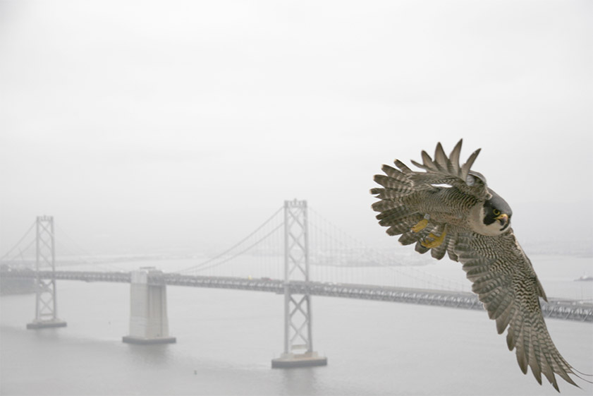
The Peregrine Falcon Recovery Story
Zeka Glucs, Ph.D.
Predatory Bird Research Group
UC Santa Cruz
zekaglucs@ucsc.edu

Slide 2
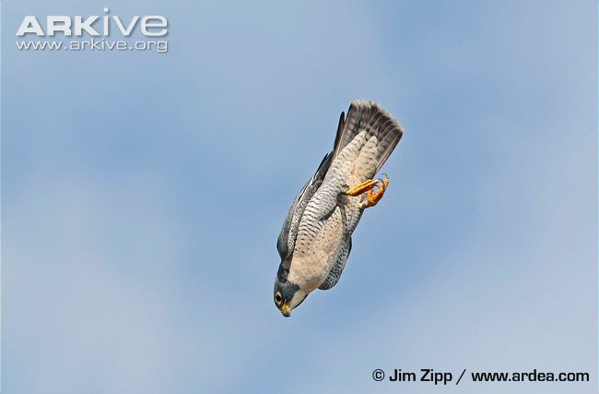
Peregrine Falcon natural history
(Falco peregrinus)
Claim to fame: Fastest animal on earth
Apex predators
  Avian Prey: waterfowl, seabirds, land birds
Max lifespan: ~20 years
Reproductive rate: 2-5 eggs/year
Range worldwide: (All continents except Antarctica)

Slide 3
Disappearance of the Peregrine Falcon in N.A.
Historical Peregrine numbers in North America
  Pacific Coast: 350-500 pairs
  North America: 106,000-120,000 pairs!
1950s- Hints of reduced reproductive success in Peregrines
1964- Peregrines Falcons extinct east of the Rockies
1965- The Madison Conference identifies pesticide toxicity as a potential mechanism for Peregrine Falcon decline
1970- 2 Peregrine pairs left in California
1973- President Nixon signs Endangered Species Act- Peregrine Falcon listed

Slide 4
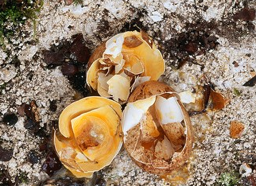
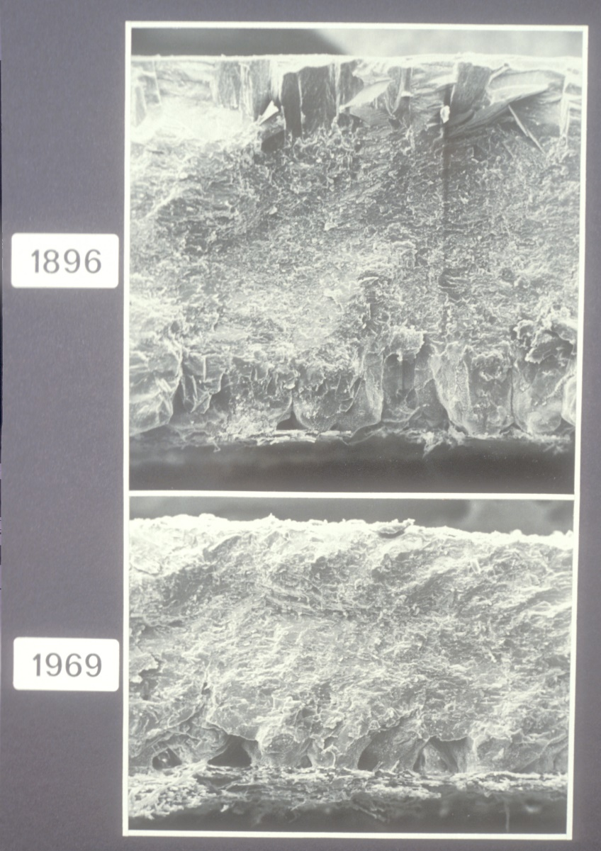
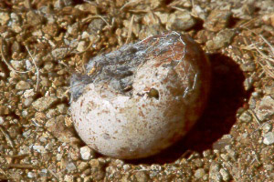
Reason for decline: Eggshell thinning/breakage reduced breeding success

Slide 5
Early evidence for Dichlorodiphenyltrichloroethane (DDT)/DDE induced eggshell thinning in Peregrine Falcons
1961- Derek Ratcliffe discovers pesticide association with raptor eggshell thickness and reproductive success on the British Isles

Slide 6
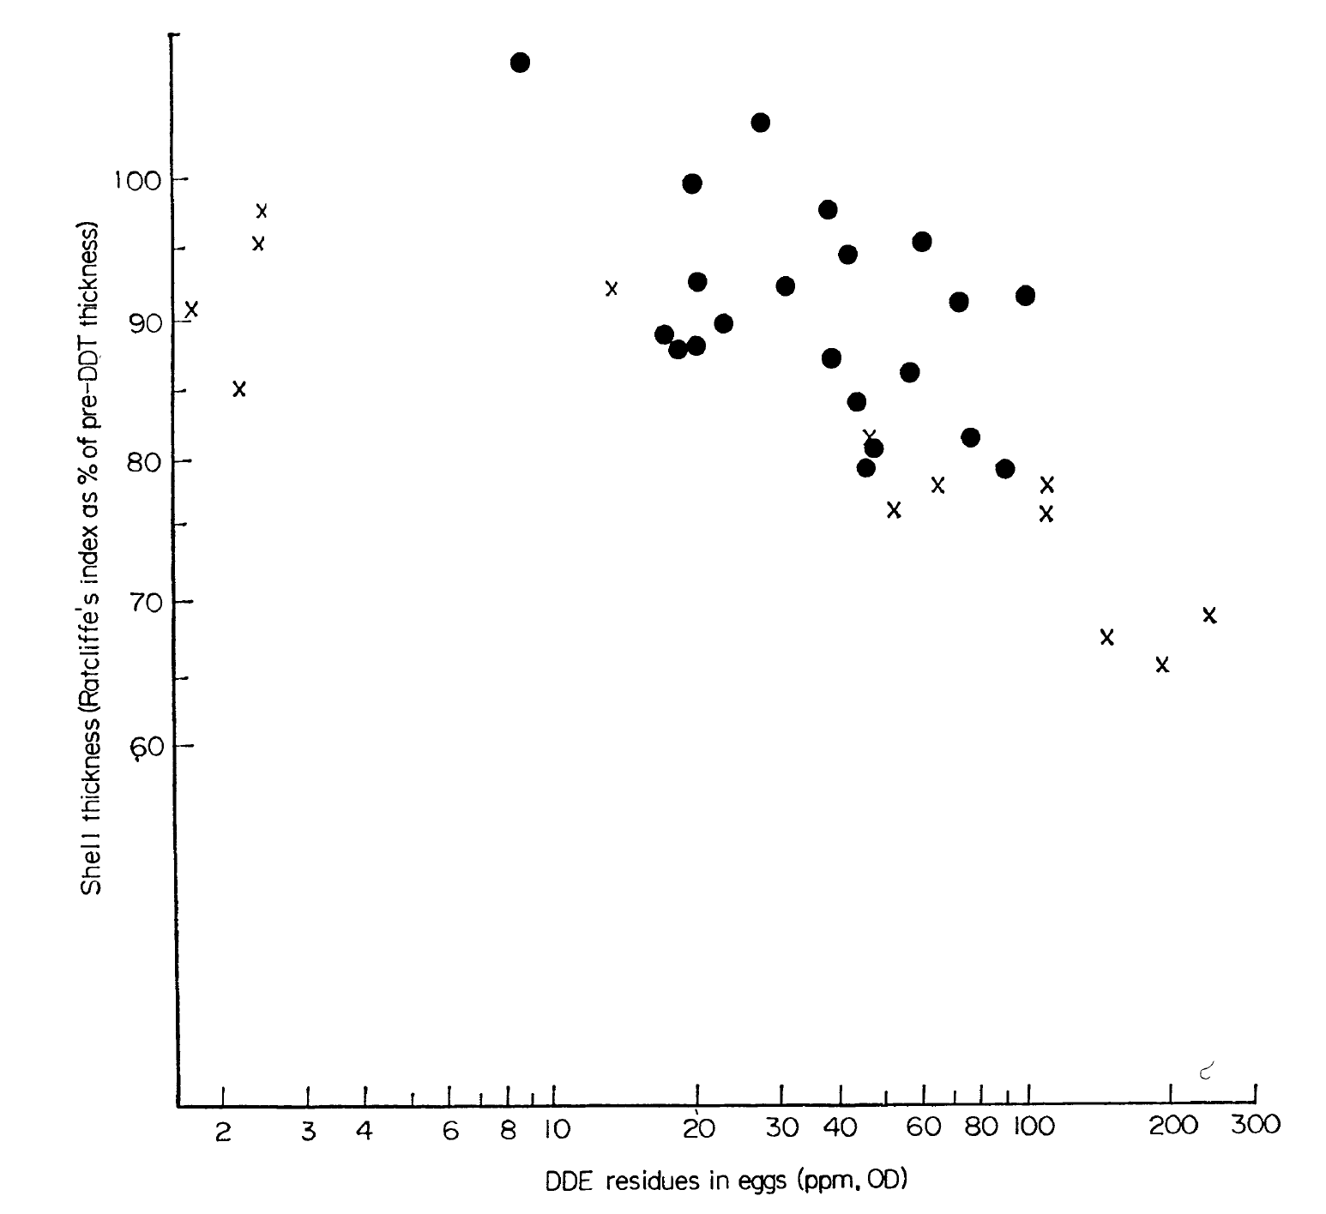
Early evidence for Dichlorodiphenyltrichloroethane (DDT)/DDE induced eggshell thinning in Peregrine Falcons
1961- Derek Ratcliffe discovers pesticide association with raptor eggshell thickness and reproductive success on the British Isles
1975-Jeffrey Lincer experimentally recreated eggshell thinning with environmentally relevant doses of DDE in American Kestrels

Slide 7
DDT/DDE induced eggshell thinning in museum specimens
Museum specimen study (Lincer 1975)
Peregrine falcon eggshell breakage

Slide 8
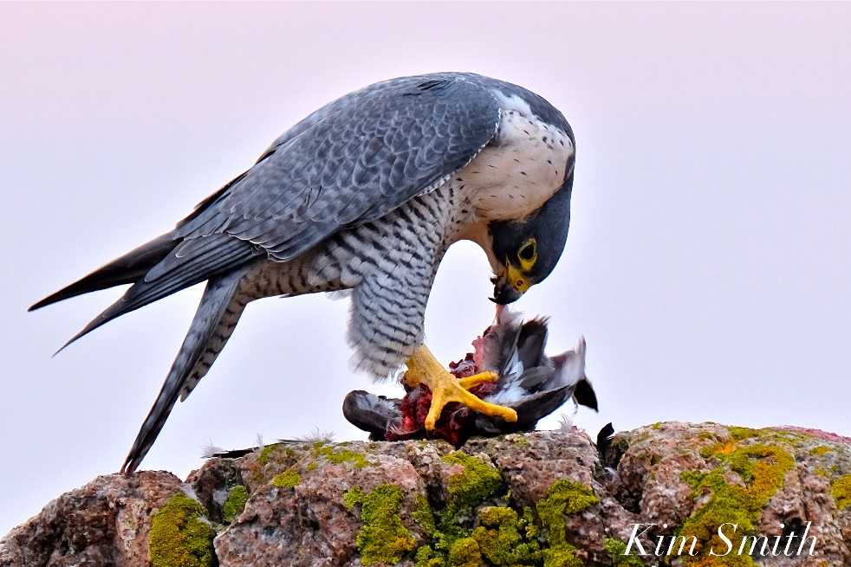
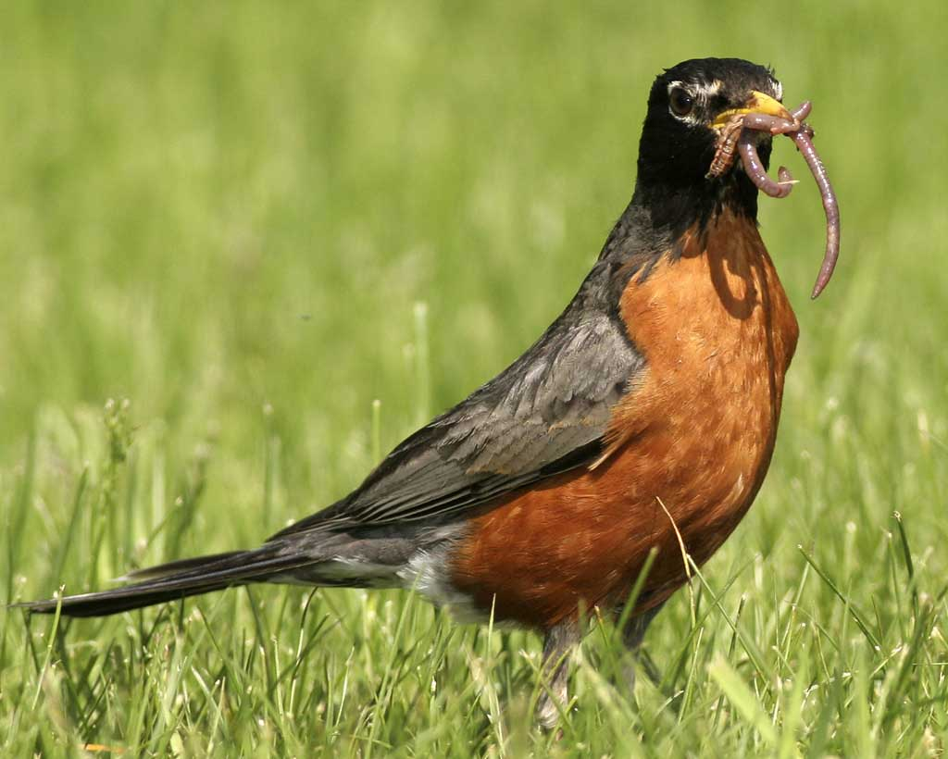
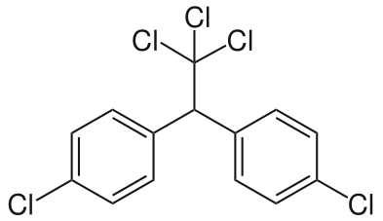
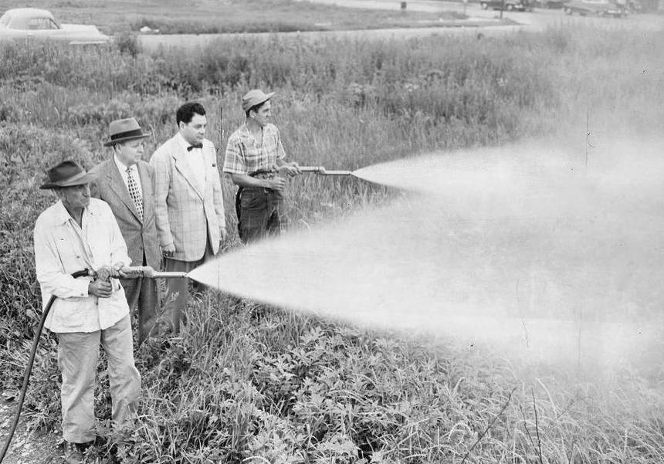
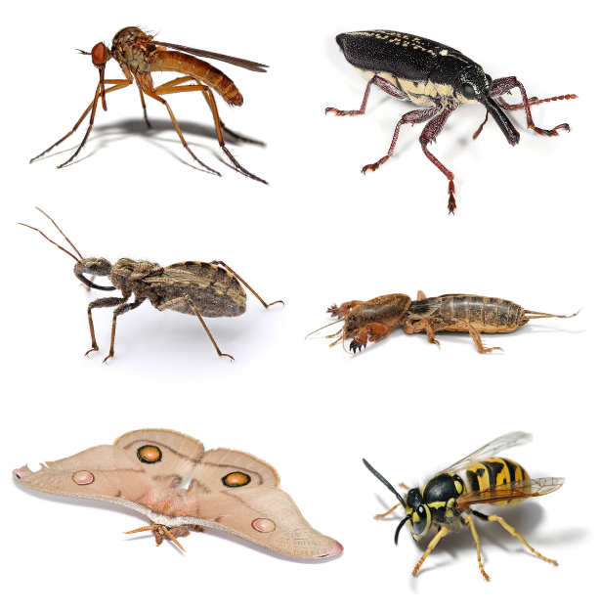
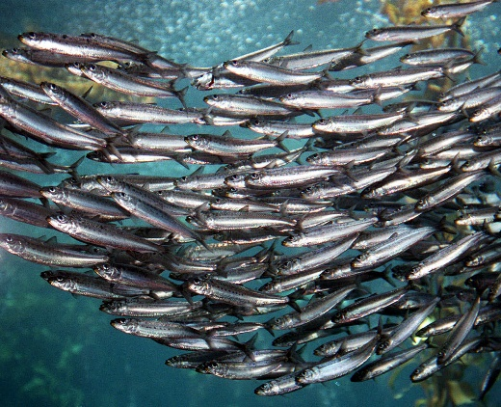
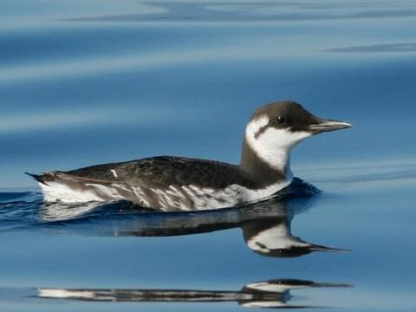
The Peregrine Falcon and DDT/DDE bioaccumulation

Slide 9
DDT: technological innovation to banned pesticide in NA in 30 years
1942 DDT invented and used by US military for disease control
1945 DDT introduced to public for agricultural use
1940s and 50s- Mass bird die offs documented for years after DDT applications, bioaccumulation of DDT observed in birds and fish
1961- Derek Ratcliffe discovers pesticide association with raptor eggshell thickness and reproductive success on the British Isles
1962- Rachel Carson’s Silent Spring published

Slide 10
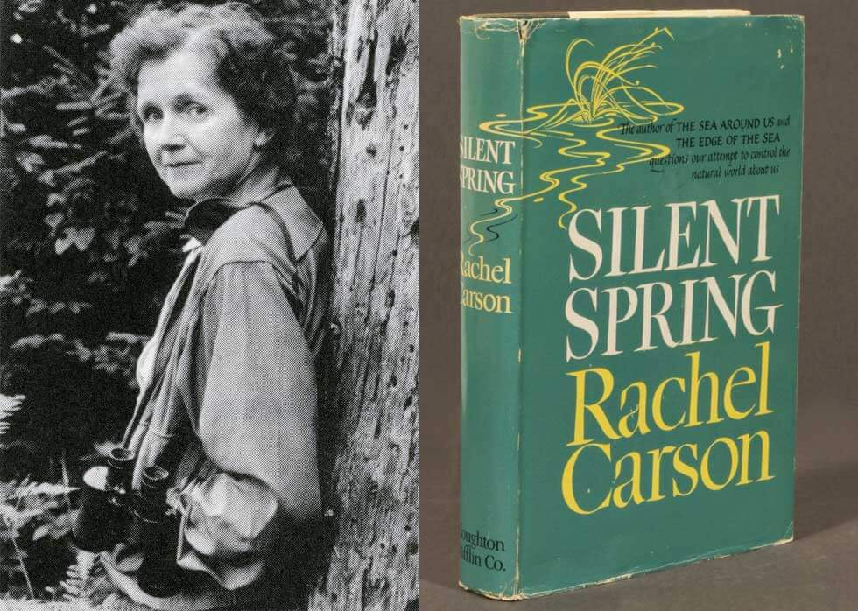

Slide 11
DDT: technological innovation to banned pesticide in NA
1967- Environmental Defense Fund is formed and files suit in Federal Court in Michigan against DDT and other pesticides. Ruling prohibits DDT use in >50 cities.
1970- petition to the Wisconsin Department of Natural Resources results in public hearing. DDT is banned throughout the state. US Environmental Protection Agency is created.
1971- US EPA holds extensive hearing on DDT
1969- DDT is banned in Canada
1972- DDT is banned in U.S. by William D. Ruckelshaus, EPA Administrator. US Supreme Court upholds ban.

Slide 12
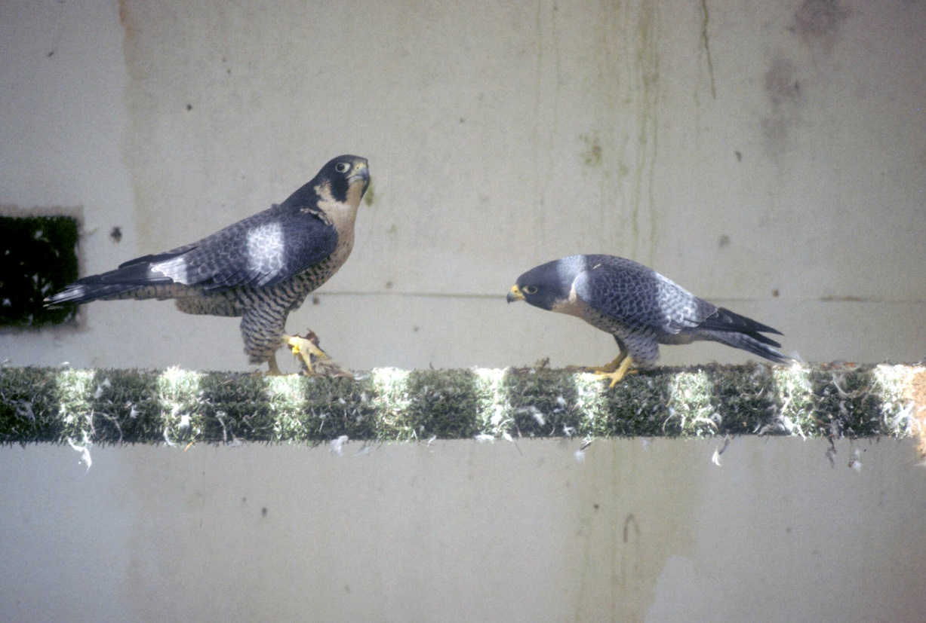
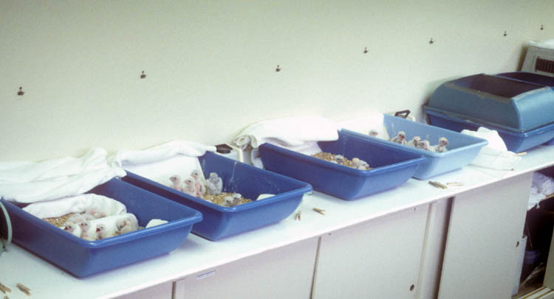
Recovery efforts for the Peregrine
1975: Santa Cruz Predatory Bird Research Group is founded

Slide 13
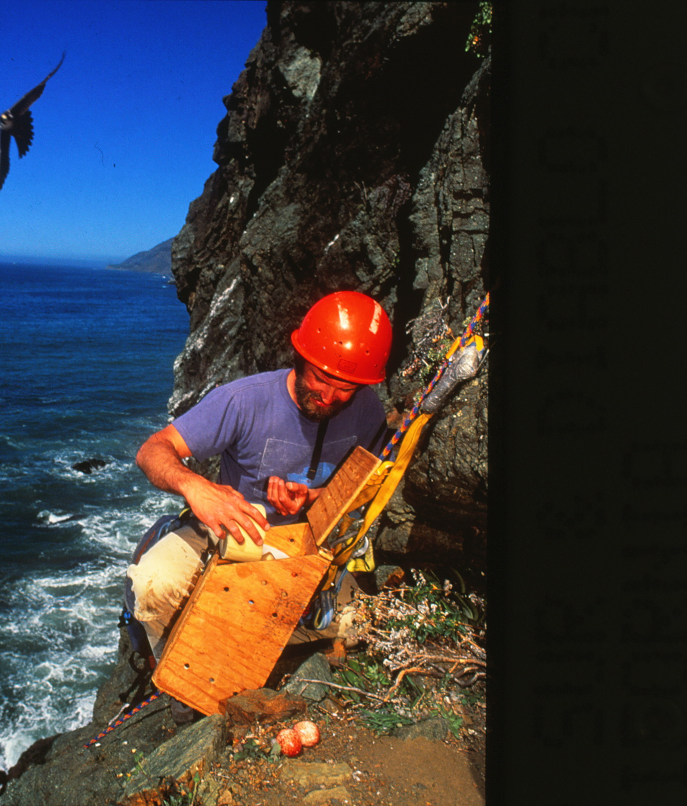
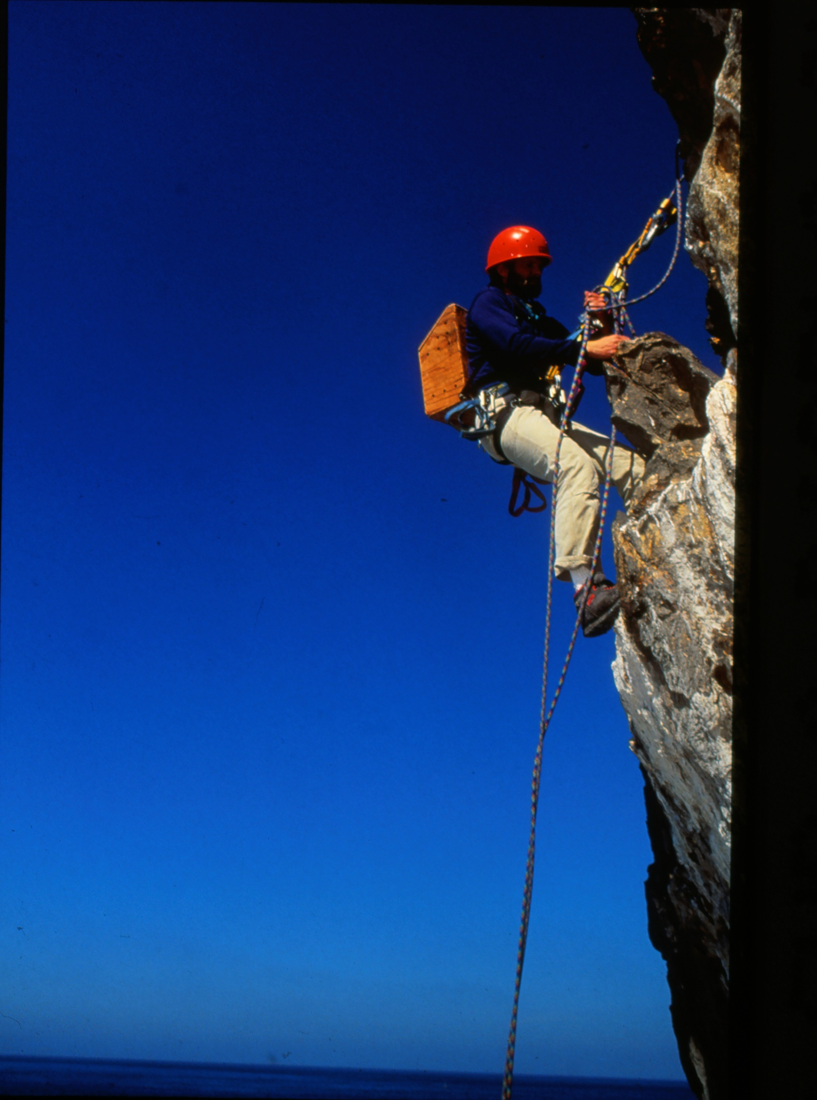
Notes:
Entering nests to collect thin-shelled eggs for lab hatching. Leave dummy eggs in nest.

Slide 14
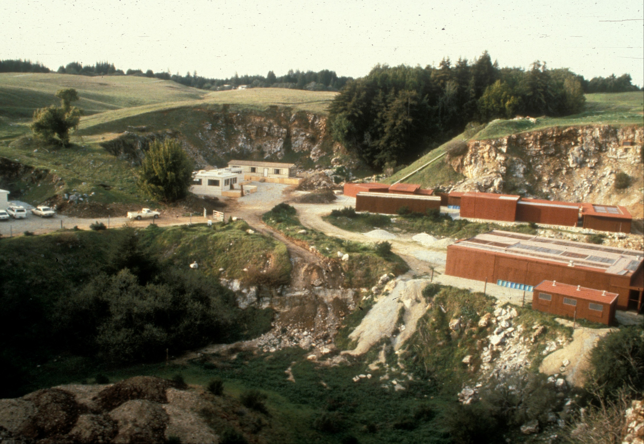
Early 1980’s

Slide 15
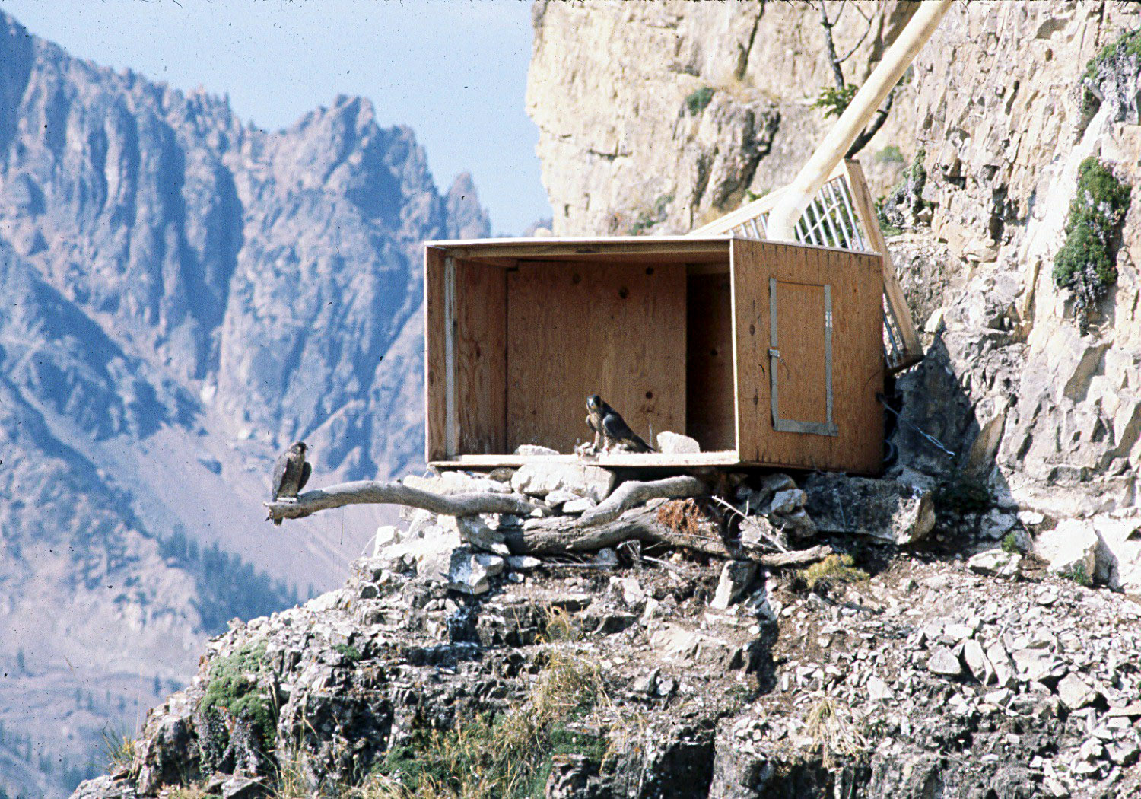

Slide 16
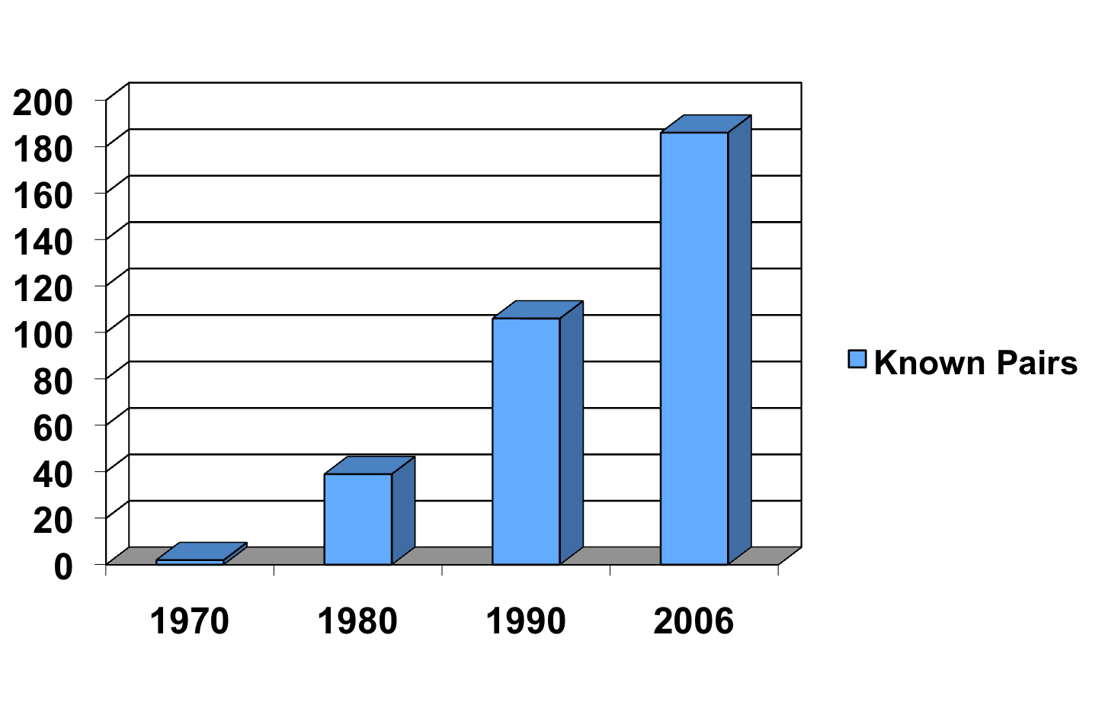
Absent DDT use, recovery in the wild can begin
Peregrine Falcon achieves full recovery in 1992 and is de-listed

Slide 17
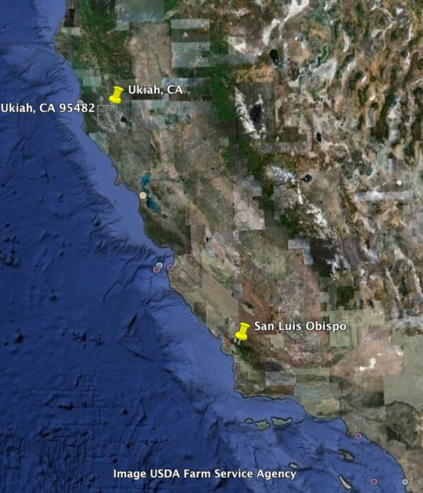
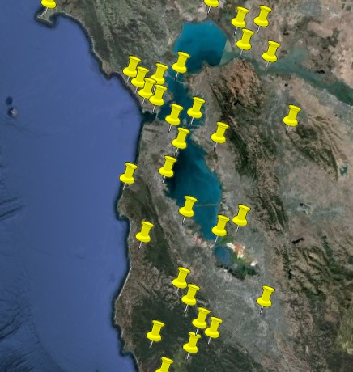
Peregrine Falcon Population Today:
San Francisco Bay Area
1970
2012

Slide 18
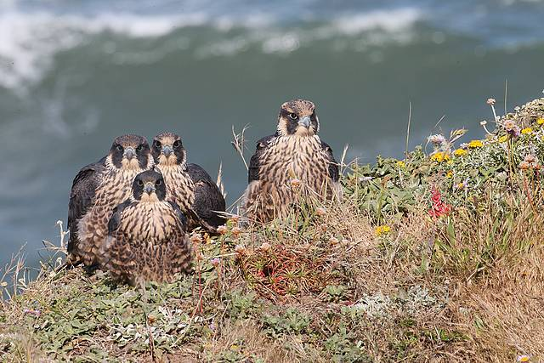
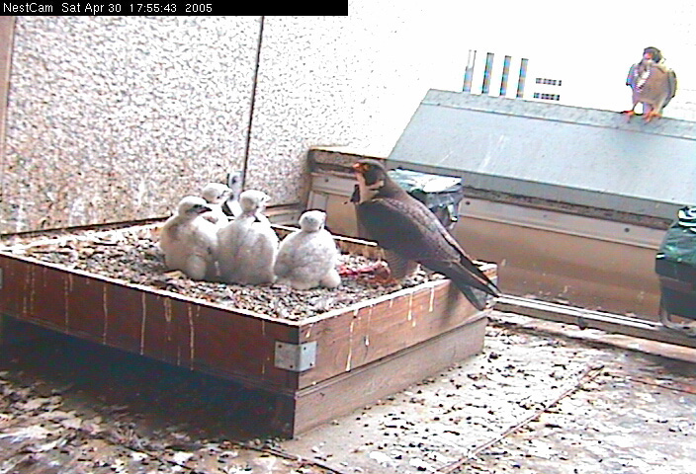
Peregrine Falcon Population Today:
San Francisco Bay Area

Slide 19
Timeline of the recovery program
Association of pop. decline with toxin (1)
Wild pop. reaches lowest point
Toxin removed
Reintroduction begins
(1000 released in WA, OR, NV, and CA)
ESA listed
Full species recovery
(2)
Peregrine Falcon
1960
1970
1980
1990
2000
2010
2020

Slide 20
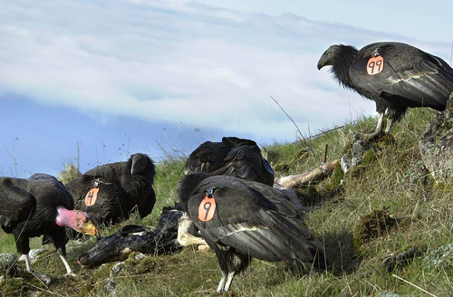
Recipes for success? Reasons for hope:
Critically endangered species can be recovered
(under the right circumstances)!
When we recognize wild species as indicators of chemicals harmful to humans, broad legislative/administrative action may be more viable

Slide 21
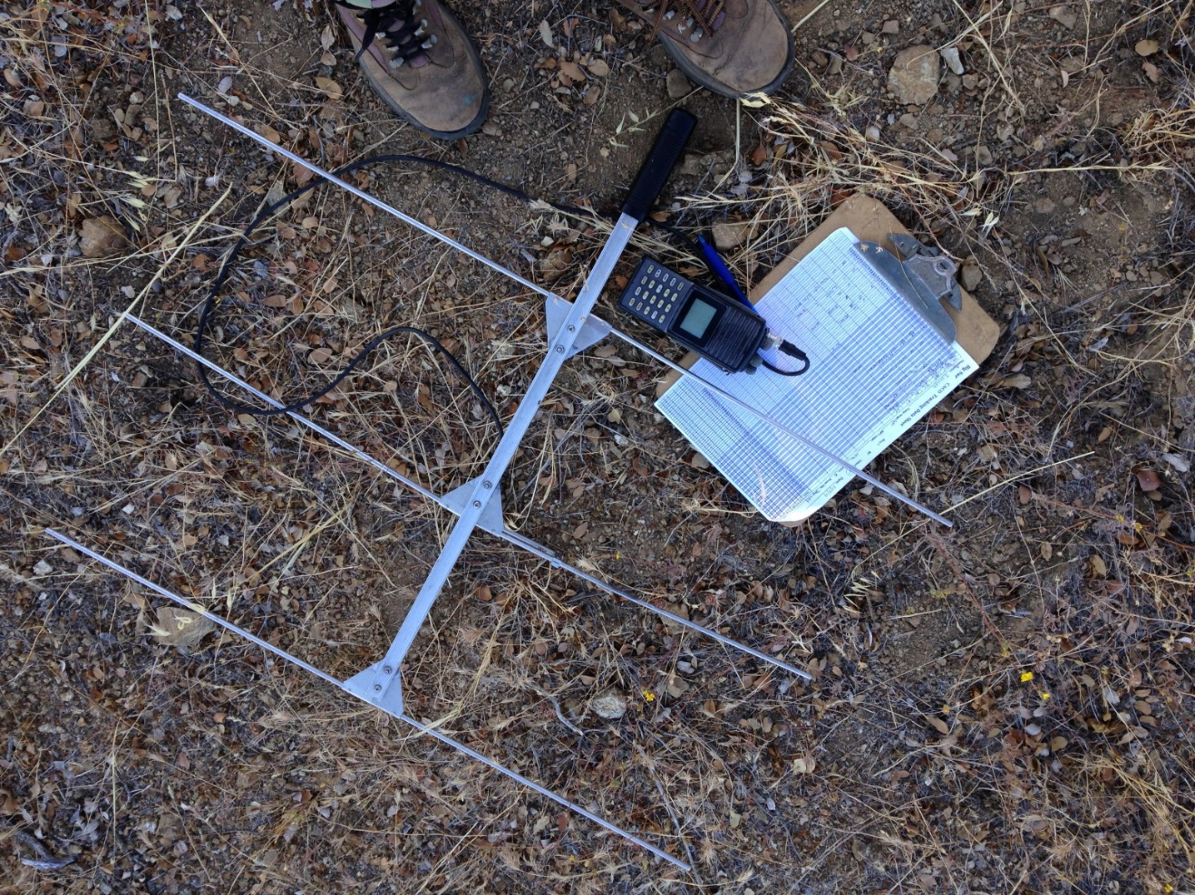
Vigilance for future toxin-mediated species declines
Importance of long-term monitoring programs and citizen scientists
Value of inter-disciplinary partnerships between scientists and managers
Increased understanding of sub-lethal effects of contaminants
  More difficult to detect, just as important!

Slide 22
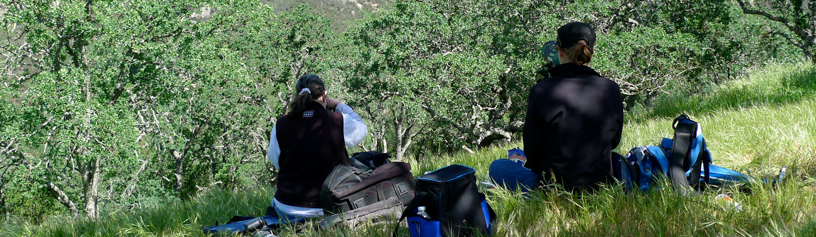
Acknowledgements
Brian Walton, Predatory Bird Research Group FOunder, UCSC
Recovery partners: field biologists, falconers, laboratory scientists, government employees and volunteers of the Peregrine Falcon recovery program

Slide 23
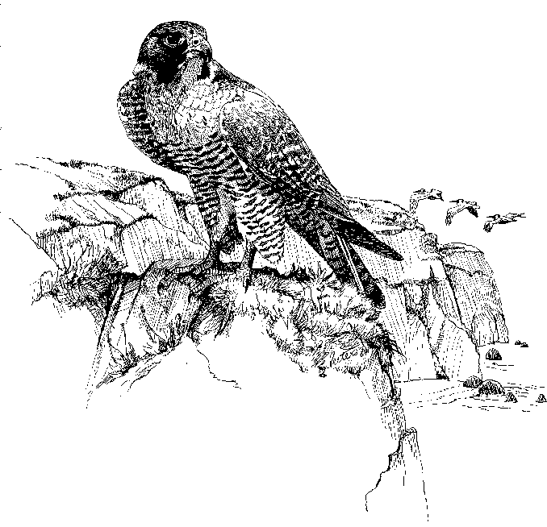


University of California
Santa Cruz Predatory Bird Research Group
@SCPBRG
https://www2.ucsc.edu/scpbrg/
zekaglucs@ucsc.edu

